Slide 1
Descriptive Statistics

Slide 2
Outline
1 Frequency Distributions and Their Graphs
2 More Graphs and Displays
3 Measures of Variation

Slide 3
Descriptive Statistics
Describes the important characteristics of a set of data.
Organize, present, and summarize data:
1. Graphically
2. Numerically

Slide 4
Important Characteristics of
Quantitative Data
“Shape, Center, and Spread”
Center: A representative or average value that indicates where the middle of the data set is located.
Variation: A measure of the amount that the values vary among themselves.
Distribution: The nature or shape of the distribution of data (such as bell-shaped, uniform, or skewed).

Slide 5
Frequency Distributions:
Three Types of Frequency distributions:
-Categorical frequency distributions;
-Ungrouped frequency distributions &
- Grouped frequency distributions.

Slide 6
Frequency Distributions
Frequency Distribution
A table that organizes data values into classes or intervals along with number of values that fall in each class (frequency, f ).
  Ungrouped Frequency Distribution – for data sets with few different values. Each value is in its own class.
  Grouped Frequency Distribution: for data sets with many different values, which are grouped together in the classes.

Slide 7
Grouped and Ungrouped
Frequency Distributions
Ungrouped
Grouped
Courses Taken | Frequency, f
1 | 25
2 | 38
3 | 217
4 | 1462
5 | 932
6 | 15
Age of Voters | Frequency, f
18-30 | 202
31-42 | 508
43-54 | 620
55-66 | 413
67-78 | 158
78-90 | 32

Slide 8
Ungrouped Frequency Distributions
Number of Peas in a Pea Pod Sample Size: 50
5 | 5 | 4 | 6 | 4
3 | 7 | 6 | 3 | 5
6 | 5 | 4 | 5 | 5
6 | 2 | 3 | 5 | 5
5 | 5 | 7 | 4 | 3
4 | 5 | 4 | 5 | 6
5 | 1 | 6 | 2 | 6
6 | 6 | 6 | 6 | 4
4 | 5 | 4 | 5 | 3
5 | 5 | 7 | 6 | 5
Peas per pod | Freq, f
Peas per pod | Freq, f
1 | 1
2 | 2
3 | 5
4 | 9
5 | 18
6 | 12
7 | 3

Slide 9
Graphs of Frequency Distributions:
Frequency Histograms
Frequency Histogram
A bar graph that represents the frequency distribution.
The horizontal scale is quantitative and measures the data values.
The vertical scale measures the frequencies of the classes.
Consecutive bars must touch.
frequency
data values

Slide 10
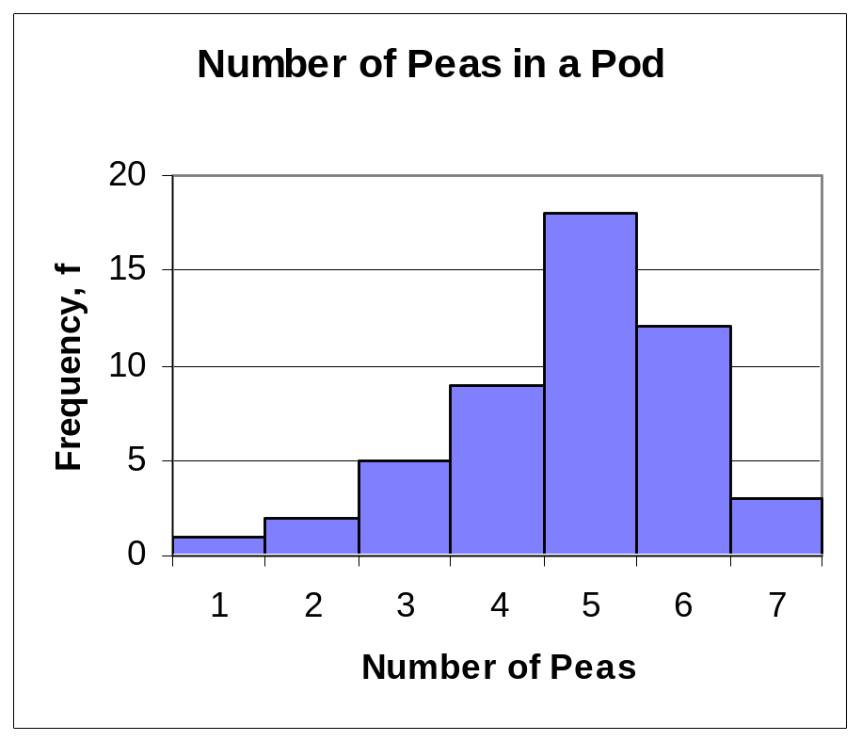
Frequency Histogram
Ex. Peas per Pod
Peas per pod | Freq, f
1 | 1
2 | 2
3 | 5
4 | 9
5 | 18
6 | 12
7 | 3

Slide 11
Grouped Frequency Distributions
Grouped Frequency Distribution
For data sets with many different values.
Groups data into 5-20 classes of equal width.
Exam Scores | Freq, f
Exam Scores | Freq, f
30-39
40-49
50-59
60-69
70-79
80-89
90-99
Exam Scores | Freq, f
30-39 | 1
40-49 | 0
50-59 | 4
60-69 | 9
70-79 | 13
80-89 | 10
90-99 | 3

Slide 12
Grouped Frequency Distribution Terms
Lower class limits: are the smallest numbers that can actually belong to different classes
Upper class limits: are the largest numbers that can actually belong to different classes
Class width: is the difference between two consecutive lower class limits

Slide 13
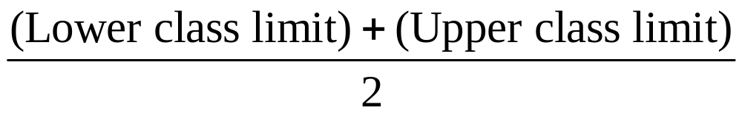
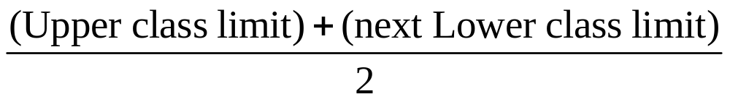
Labeling Grouped Frequency Distributions
Class midpoints: the value halfway between LCL and UCL:
Class boundaries: the value halfway between an UCL and the next LCL

Slide 14
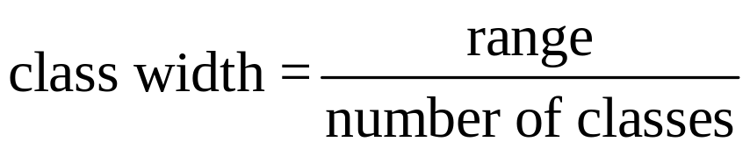
Constructing a Grouped Frequency Distribution
Determine the range of the data:
  Range = highest data value – lowest data value
Decide on the number of classes.
Find the class width:

Slide 15
Constructing a Frequency Distribution
Find the class limits.
  Choose the first LCL: use the minimum data entry or something smaller that is convenient.
  Find the remaining LCLs: add the class width to the lower limit of the preceding class.
  Find the UCLs: Remember that classes must cover all data values and cannot overlap.
Find the frequencies for each class.

Slide 16
“Shape” of Distributions
Symmetric
Data is symmetric if the left half of its histogram is roughly a mirror image of its right half.
Skewed
Data is skewed if it is not symmetric and if it extends more to one side than the other.
Uniform
Data is uniform if it is equally distributed (on a histogram, all the bars are the same height or approximately the same height).

Slide 17
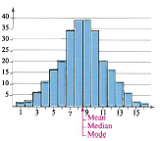
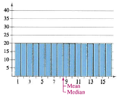
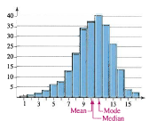
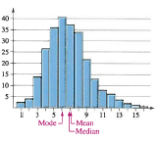
The Shape of Distributions
Symmetric
Uniform
Skewed left
Skewed Right

Slide 18
Outliers
Outliers
Unusual data values as compared to the rest of the set. They may be distinguished by gaps in a histogram.

Slide 19
Other Graphs
Besides Histograms, there are other methods of graphing quantitative data:
  Stem and Leaf Plots
  Dot Plots

Slide 20
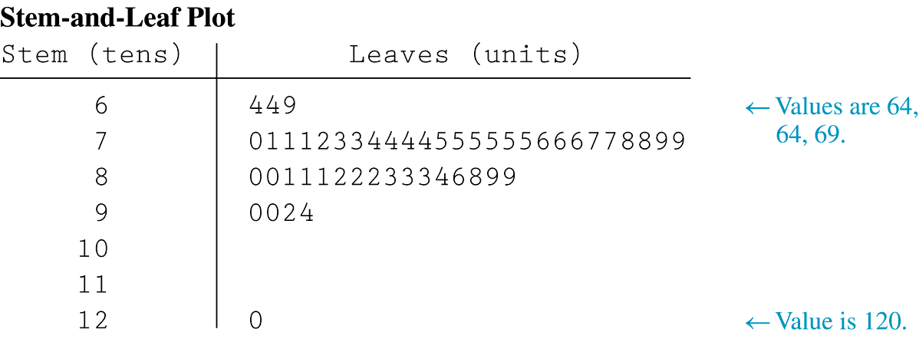
Stem and Leaf Plots
Represents data by separating each data value into two parts: the stem (such as the leftmost digit) and the leaf (such as the rightmost digit)

Slide 21
Constructing Stem and Leaf Plots
Split each data value at the same place value to form the stem and a leaf. (Want 5-20 stems).
Arrange all possible stems vertically so there are no missing stems.
Write each leaf to the right of its stem, in order.
Create a key to recreate the data.
Variations of stem plots:
  Split stems
  Back to back stem plots.

Slide 22
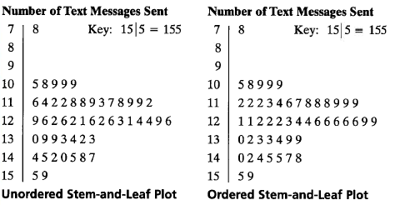
Constructing a Stem-and-Leaf Plot
Include a key to identify the values of the data.

Slide 23
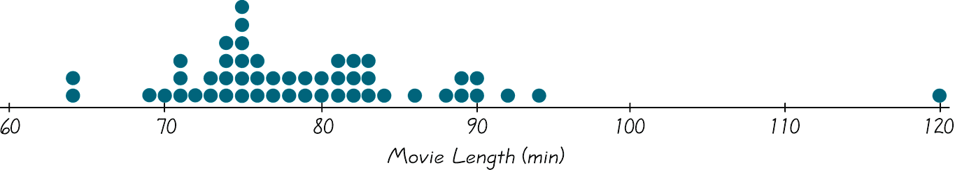
Dot Plots
Dot plot
Consists of a graph in which each data value is plotted as a point along a scale of values
Figure 2-5

Slide 24
Measures of Variation (“Spread”)
Another important characteristic of quantitative data is how much the data varies, or is spread out.
The 2 most common method of measuring spread are:
  Range
  Standard deviation and Variance

Slide 25
Range
Range
The difference between the maximum and minimum data entries in the set.
The data must be quantitative.
Range = (Max. data entry) – (Min. data entry)

Slide 26
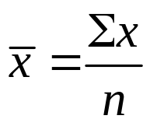

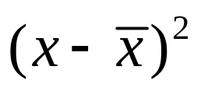
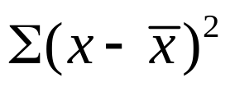
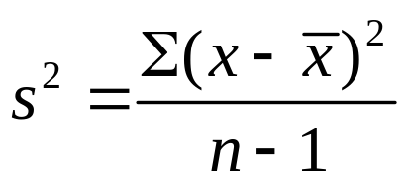
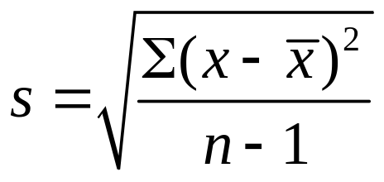
Formula for finding Sample Variance & Standard Deviation
Find the mean of the sample data set.
Find deviation of each entry.
Square each deviation.
Add to get the sum of the deviations squared.
Divide by n – 1 to get the sample variance.
Find the square root to get the sample standard deviation.

Slide 27
How to find Variance and Standard Deviation of a data set

Slide 28
Variance
  Variance is the average squared deviation from the mean of a set of data. It is used to find the standard deviation.

Slide 29
Variance
1. Find the mean of the data.
Hint – mean is the average so add up the values and divide by the number of items.
Subtract the mean from each value – the
result is called the deviation from the mean.
3. Square each deviation of the mean.
4. Find the sum of the squares.
5. Divide the total by the number of items.

Slide 30
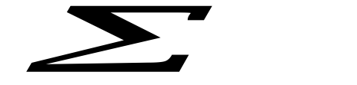
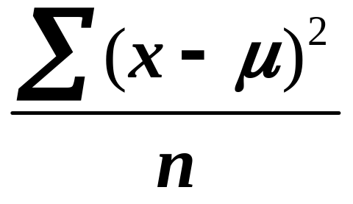

Variance Formula
The variance formula includes the Sigma Notation, , which represents the sum of all the items to the right of Sigma.
Mean is represented by and n is the number of items.

Slide 31

Standard Deviation
Standard Deviation shows the variation in data. If the data is close together, the standard deviation will be small. If the data is spread out, the standard deviation will be large.
Standard Deviation is often denoted by the lowercase Greek letter sigma, .

Slide 32
Standard Deviation
Find the variance.
a) Find the mean of the data.
b) Subtract the mean from each value.
c) Square each deviation of the mean.
d) Find the sum of the squares.
e) Divide the total by the number of items.
Take the square root of the variance.

Slide 33
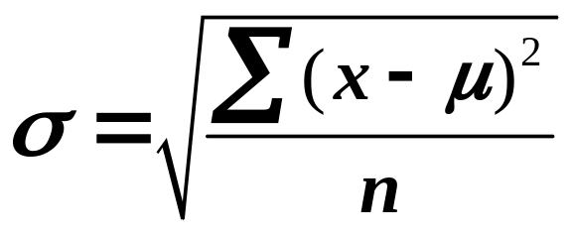
Standard Deviation Formula
The standard deviation formula can be represented using Sigma Notation:
Notice the standard deviation formula is the square root of the variance.

Slide 34
Find the variance and standard deviation
The math test scores of five students are: 92,88,80,68 and 52.
1) Find the mean: (92+88+80+68+52)/5 = 76.
2) Find the deviation from the mean:
92-76=16
88-76=12
80-76=4
68-76= -8
52-76= -24

Slide 35
Grade Scores | Mean | Mean deviation | Mean deviation squared
92 | 76 | 16 | 256
88 | 76 | 12 | 144
80 | 76 | 4 | 16
68 | 76 | -8 | 64
52 | 76 | -24 | 576
 |  |  | Sum of squares = 1056

Slide 36
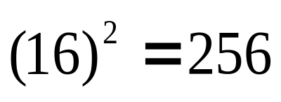
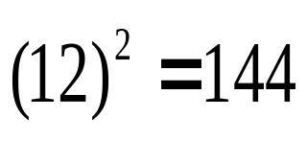
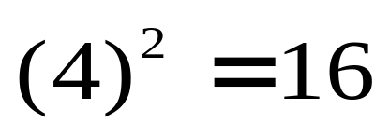
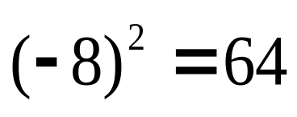
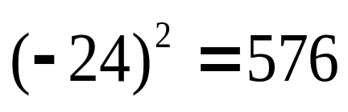
Find the variance and standard deviation
The math test scores of five students are: 92,88,80,68 and 52.
3) Square the deviation from the mean:

Slide 37
Find the variance and standard deviation
The math test scores of five students are: 92,88,80,68 and 52.
4) Find the sum of the squares of the deviation from the mean:
256+144+16+64+576= 1056
5) Divide by the number of data items to find the variance:
1056/5 = 211.2

Slide 38
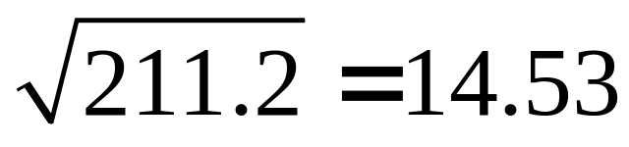
Find the variance and standard deviation
The math test scores of five students are: 92,88,80,68 and 52.
6) Find the square root of the variance:
Thus the standard deviation of the test scores is 14.53.

Slide 39
Standard Deviation
A different math class took the same test with these five test scores: 92,92,92,52,52.
Find the standard deviation for this class.

Slide 40
Hint:
Find the mean of the data.
Subtract the mean from each value – called the deviation from the mean.
Square each deviation of the mean.
Find the sum of the squares.
Divide the total by the number of items – result is the variance.
Take the square root of the variance – result is the standard deviation.

Slide 41

Solve:
A different math class took the same test with these five test scores: 92,92,92,52,52.
Find the standard deviation for this class.
Answer Now

Slide 42
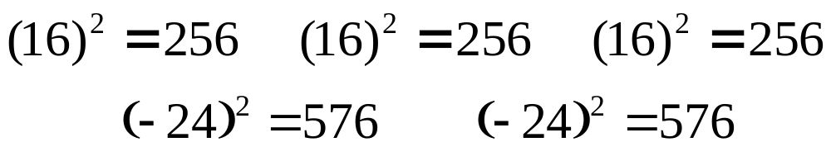
The math test scores of five students are: 92,92,92,52 and 52.
1) Find the mean: (92+92+92+52+52)/5 = 76
2) Find the deviation from the mean:
92-76=16 92-76=16 92-76=16
52-76= -24 52-76= -24
3) Square the deviation from the mean:
4) Find the sum of the squares:
256+256+256+576+576= 1920

Slide 43
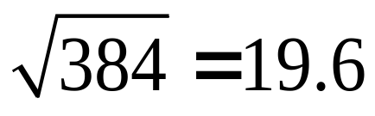
The math test scores of five students are: 92,92,92,52 and 52.
5) Divide the sum of the squares by the number of items :
1920/5 = 384 variance
6) Find the square root of the variance:
Thus the standard deviation of the second set of test scores is 19.6.

Slide 44

Analyzing the data:
Consider both sets of scores. Both classes have the same mean, 76. However, each class does not have the same scores. Thus we use the standard deviation to show the variation in the scores. With a standard variation of 14.53 for the first class and 19.6 for the second class, what does this tell us?
Answer Now

Slide 45
Analyzing the data: Interpretation
Class A: 92,88,80,68,52
Class B: 92,92,92,52,52
With a standard variation of 14.53 for the first class and 19.6 for the second class, the scores from the second class shows more variation and hence would be more spread out than the scores in the first class.

Slide 46
Summary:
As we have seen, standard deviation measures the dispersion (variation) of data.
The greater the value of the standard deviation, the further the data tend to be dispersed (vary) from the mean.

Slide 47
Sample versus Population
Standard Deviation and Variance
Sample Population
Statistics: Parameters:
Mean x µ
Standard s σ
Deviation
Variance s² σ²

Slide 48
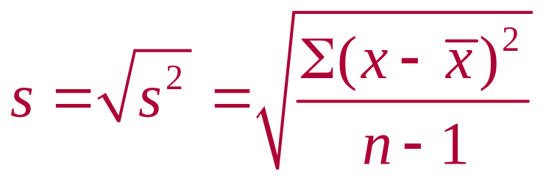
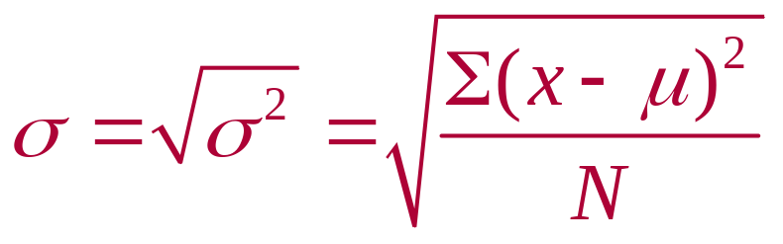
Sample versus Population
Standard Deviation
Note: Unlike x and µ, the formulas for s and σ are not mathematically the same:
Sample Standard Deviation (Standard Error (SE))
Population Standard Deviation

Slide 49
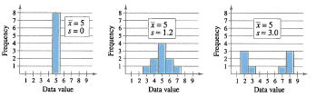
Interpreting Standard Deviation
Standard deviation is a measure of the typical amount an entry deviates from the mean.
The more the entries are spread out, the greater the standard deviation.

Slide 50
Data: Levels of measurement (Nominal, Ordinal or Interval/ratio)
Nominal: (e.g: gender, name of places etc)
  Categorical, Qualitative, non-parametric (frequencies, proportions and percentages)
    Tests: Tests for proportion, difference of two proportions and chi-square tests for independence
Interval/Ratio: (e.g. Temperature, Kg, cm etc)
  Quantitative, parametric or non-parametric (mean, standard deviation, variance, etc)
    Tests: Tests for a mean, difference of two means (independent samples), difference of two means (paired), relationships (correlation, regressions) etc.
Ordinal: (e.g. Strongly agree, strongly disagree etc)
Ordinal data can be categorical, qualitative or quantitative so types of tests used depends on the purpose of the analysis

